Slide 1
Best Gadget Finder
UNDER THE GUIDANCE OF PROF. ANUJ SAINI WITH PACKT AND TEAMEPIC
TEAM MEMBERS
MR. SOURABH MANJREKAR
MS. NEHA SAVAKHANDE
MR. ZAHOOR ANSARI

Slide 2
Outline
Introduction
Problem statement & objectives
Architecture
Web scraping
Data cleaning
Data standardization
Name matching
Data mapping
Elasticsearch
API development
Data testing
Deployment
Conclusion
Future scope
References

Slide 3
Introduction
Since Internet has been around for quite some time, there have been a lot of businesses moving online
After Jio came into existence, more and more local vendors are coming online, since they are able to use internet locally
Even Covid has contributes to a rise in businesses coming online
There are a number of similar products available online

Slide 4
Problem statement & objectives
Problem statement
Many e-commerce websites are available on the Internet
There is a need to compare the products on a single platform
Objectives
To make use of modern techniques to create a comparative UI
To compare prices of gadgets across various e-commerce platforms
To provide average rating and availability of the products

Slide 5
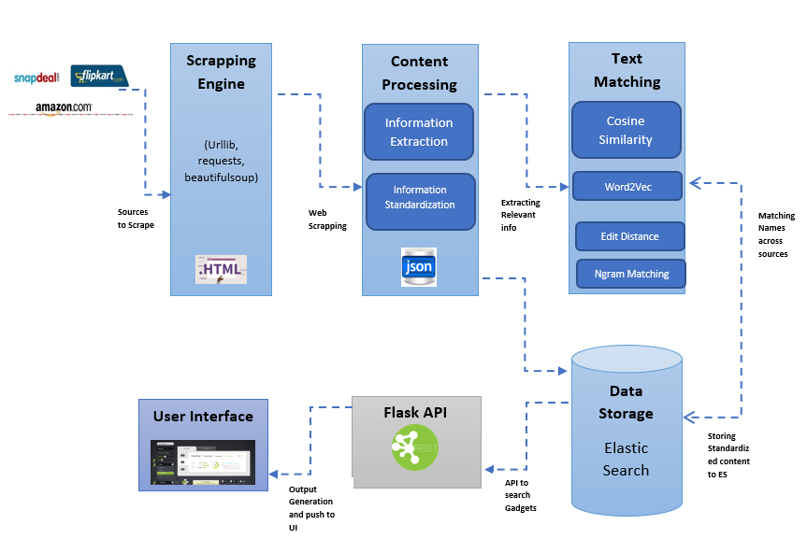
Architecture

Slide 6
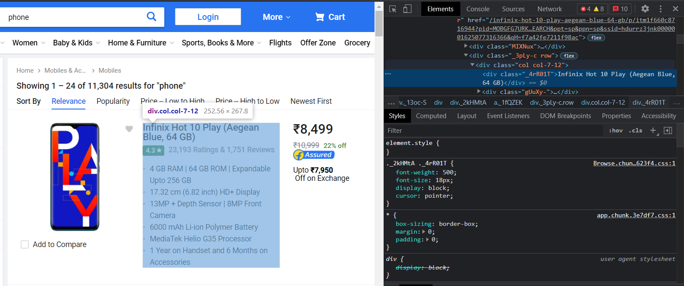



Web scraping
Process of extracting information and data from a website and transforming it into structured data
Steps of web scraping:
Inspect the webpage
Parse the webpage html using Beautiful Soup
Search for html elements
Looping through elements and saving variables

Slide 7
Data cleaning
The process of fixing or removing incorrect, corrupted, incorrectly formatted, duplicate, or incomplete data within a dataset.
Use of Pandas
Data cleaning, data manipulation and analysis
In this stage, we removed special characters and Rs symbols to make the data standard. This helps to ingest data in a master dataset where we can perform certain operations on them.

Slide 8
Data standardization
To meet the user requirements, we have added two columns:
Availability
Synonyms
E.g. Product - REDMI 9i (Midnight Black, 64 GB)
Synonyms - REDMI 9i | REDMI 9i Midnight Black | REDMI 9i 64 GB

Slide 9
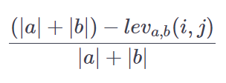
Name matching
As we had three different source files with the same product but with different way of product name.
We used Fuzzywuzzy approach for name matching
Fuzzywuzzy library
Levenshtein distance - metric to measure how apart are two sequences of words
Formula to calculate Levenshtein distance:
First Name | Second Name | Similarity ratio
Redmi 9A Nature Green 2GB RAM 32GB Storage | Redmi 9A Nature Green 32 GB | 88
Samsung Galaxy M11 Metallic Blue 4GB RAM | SAMSUNG Galaxy M11 Metallic Blue 32 GB | 91
Oppo A31 Fantasy White 6GB RAM | OPPO A31 Fantasy White 64 GB | 90
Nokia 105 Single SIM Black | Nokia 105 | 100
Redmi Note 10 Aqua Green 6GB RAM | REDMI Note 10 Aqua Green 128 GB | 87

Slide 10
Data mapping
With the data matching algorithm, we ran the algorithm against all the dataset with respect to others. This enabled us to check for matching names and map the data from other sources to create a master dataset file.
Following was the column set for the master dataset:
[ 'Cleaned_Name', 'New_Name', 'Amazon_Name', 'Flipkart_Name',
'Snapdeal_Name', 'Amazon_SalesPrice', 'Flipkart_SalesPrice',
'Snapdeal_SalesPrice', 'Amazon_OriginalPrice', 'Flipkart_OriginalPrice',
'Snapdeal_OriginalPrice', 'Amazon_Rating', 'Flipkart_Rating',
'Snapdeal_Rating', 'Amazon_ProductLink', 'Flipkart_ProductLink',
'Snapdeal_ProductLink', 'Amazon_ImageLink', 'Flipkart_ImageLink',
'Snapdeal_ImageLink']

Slide 11
Elastic Search
Elasticsearch is a NoSQL database, which performs full text search
Elasticsearch is scalable for production environment and can handle millions of entries, and still give results within few seconds
We installed the Elasticsearch service and then using the Elasticsearch client in Python, we indexed the master data file and got the data loaded in the database
We were able to query the data and created a match query
We can make more refined search by using the mapping file in Elasticsearch

Slide 12
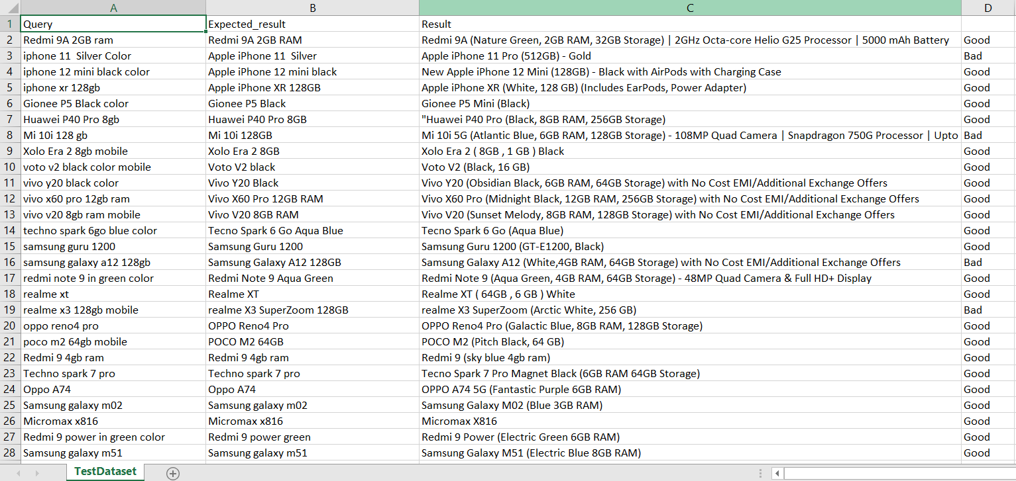
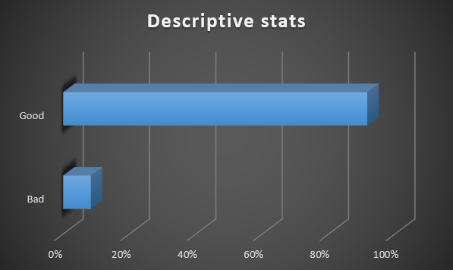
Data testing
Input given to a program during test execution.
Represents data that affects or affected by software execution while testing.

Slide 13
UI Development
We have created a wireframe design using the software Figma
In frontend we have created a website with the help of html, CSS and bootstrap framework.
Bootstrap is a powerful toolkit - a collection of HTML, CSS, and JavaScript tools for creating and building web pages and web applications.
As a final result we can see a website with three sources Amazon Flipkart and Snapdeal.
There is a button provided like buy now, by clicking on it user will automatically get redirected to the product link and can buy the desired product.

Slide 14
Deployment
After building the API and Flask and using the Flask container to serve the HTML page for our search and results section
We had to connect it to the Elasticsearch database and query the database
In backend we have used flask API which is used for managing http requests.
We used fetch API function to get the data. And used this data to create a frontend.
We returned the data in a JSON format, which was then used by flask to display the information on the webpage. It was hosted on the local host.
We added 20 results, relevant to the keyword. We can update and change this feature as the need arises.

Slide 15
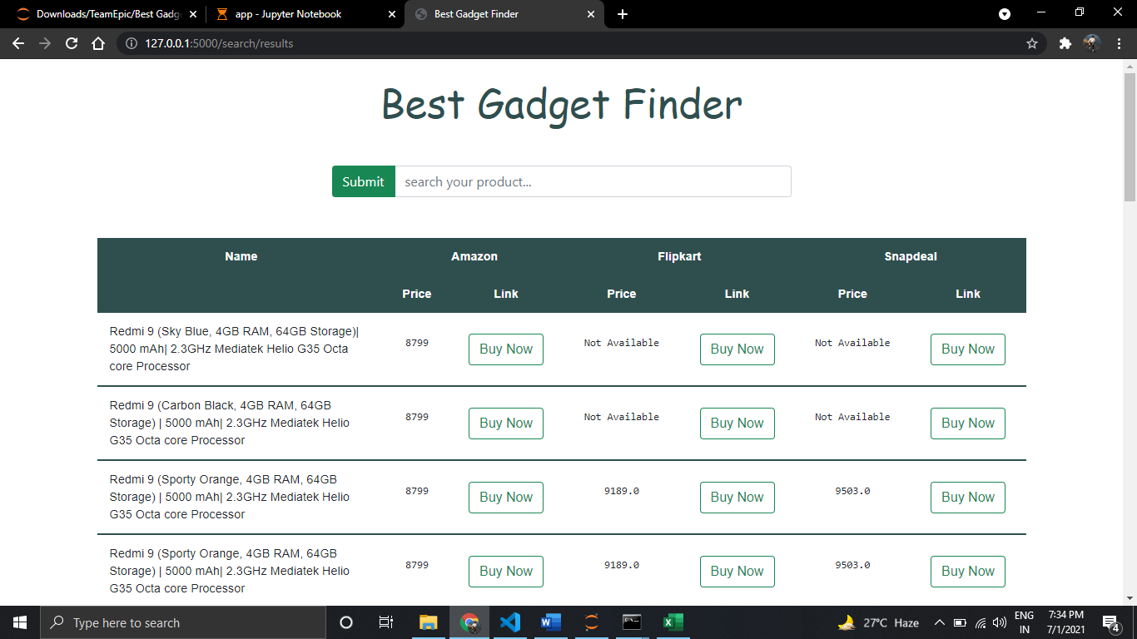

Slide 16






Technology stack

Slide 17
Conclusion
We collected data from online sources and we could pinpoint data that needs to be extracted. This technique can be used to extract any type of data from the internet.
We were able to store the data in a csv file to consume later which can be used to create data files.
We had to perform lot of data cleanup and data mapping which helps us in building and maintain datasets.
We extracted synonyms and relevant data that are more articulate.
We used Elasticsearch to search, get the data indexed, and then query the data as per our needs.
We built an API to communicate with the no sql database.
We were able to test the data with Postman and check if we were able to get the data from the database.
We built a web container, which served HTML through Flask and displayed the data from all the three websites. It has got the prices and then takes the user to the buying page of the site.

Slide 18
Future scope
We can get data from various coupon websites, and add that data to factor the price. This helps potential buyers to get more offer and take informed decisions.
We can scrape data from multiple websites and compare similar products so that there are various options for the end user.
We can add more products other than mobile phones, and we can compare prices for different products.
We can add data like aggregate reviews, individual reviews, or even the image of the product.

Slide 19
Thank You

